Slide 1
Java Programming
Java Programming IT-11

Slide 2
Event Handling
What is an Event?
Change in the state of an object is known as event i.e. event describes the change in state of source.
Events are generated as result of user interaction with the graphical user interface components.
For example, clicking on a button, moving the mouse, entering a character through keyboard,selecting an item from list, scrolling the page are the activities that causes an event to happen.

Slide 3
Types of Event
The events can be broadly classified into two categories:
Foreground Events –
Those events which require the direct interaction of user.
They are generated as consequences of a person interacting with the graphical components in Graphical User Interface.
For example, clicking on a button, moving the mouse, entering a character through keyboard,selecting an item from list, scrolling the page etc.

Slide 4
Types of Event
Background Events –
Those events that require the interaction of end user are known as background events.
Operating system interrupts, hardware or software failure, timer expires, an operation completion are the example of background events.

Slide 5
What is Event Handling?
Event Handling is the mechanism that controls the event and decides what should happen if an event occurs.
This mechanism have the code which is known as event handler that is executed when an event occurs.
Java Uses the Delegation Event Model to handle the events.
This model defines the standard mechanism to generate and handle the events.
Let's have a brief introduction to this model.

Slide 6
Delegation Event Model
The Delegation Event Model has the following key participants namely:
Source –
The source is an object on which event occurs.
Source is responsible for providing information of the occurred event to it's handler.
Listener –
It is also known as event handler.
Listener is responsible for generating response to an event.
Listener waits until it receives an event. Once the event is received , the listener process the event an then returns.

Slide 7
Delegation Event Model
The benefit of this approach is that the user interface logic is completely separated from the logic that generates the event.
The user interface element is able to delegate the processing of an event to the separate piece of code.
In this model ,Listener needs to be registered with the source object so that the listener can receive the event notification.
This is an efficient way of handling the event because the event notifications are sent only to those listener that want to receive them.

Slide 8
Steps involved in event handling
The User clicks the button and the event is generated.
Now the object of concerned event class is created automatically and information about the source and the event get populated with in same object.
Event object is forwarded to the method of registered listener class.
the method is now get executed and returns.

Slide 9
AWT Event Classes:
Following is the list of commonly used event classes.
AWTEvent
It is the root event class for all AWT events.
ActionEvent
The ActionEvent is generated when button is clicked or the item of a list is double clicked.
KeyEvent
On entering the character the Key event is generated.
MouseEvent
This event indicates a mouse action occurred in a component
TextEvent
The object of this class represents the text events.

Slide 10
AWT Event Classes:
WindowEvent
The object of this class represents the change in state of a window.
ComponentEvent
The object of this class represents the change in state of a window.
ContainerEvent
The object of this class represents the change in state of a window.

Slide 11
Java ActionListener Interface
The Java ActionListener is notified whenever you click on the button or menu item.
It is notified against ActionEvent.
The ActionListener interface is found in java.awt.event package.
It has only one method: actionPerformed().
actionPerformed() method
The actionPerformed() method is invoked automatically whenever you click on the registered component

Slide 12
Example
import java.awt.*;
import java.awt.event.*;
public class ActionListenerExample1
{
public static void main(String[] args)
{
Frame f=new Frame("ActionListener Example");
final TextField tf=new TextField();
tf.setBounds(50,50, 150,20);
Button b=new Button("Click Here");
b.setBounds(50,100,60,30);

Slide 13
Example
b.addActionListener(this
new ActionListener( )
{ public void actionPerformed(ActionEvent e)
{
tf.setText("Welcome to pune");
}
} );
} f.add(b); f.add(tf);
f.setSize(400,400);
f.setLayout(null);
f.setVisible(true);
}
}

Slide 14
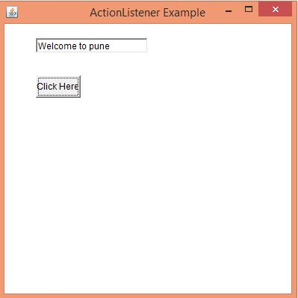
Example

Slide 15
TextField Example
import java.awt.*;
import java.awt.event.*;
public class TextFieldExample extends Frame implements ActionListener{
TextField tf1,tf2,tf3;
Button b1,b2;
TextFieldExample(){
tf1=new TextField();
tf1.setBounds(50,50,150,20);
tf2=new TextField();
tf2.setBounds(50,100,150,20);
tf3=new TextField();
tf3.setBounds(50,150,150,20);

Slide 16
TextField Example
tf3.setEditable(false);
b1=new Button("+");
b1.setBounds(50,200,50,50);
b2=new Button("-");
b2.setBounds(120,200,50,50);
b1.addActionListener(this);
b2.addActionListener(this);
add(tf1);add(tf2);add(tf3);add(b1);add(b2);
setSize(300,300);
setLayout(null);
setVisible(true);
}

Slide 17
TextField Example
public void actionPerformed(ActionEvent e) {
String s1=tf1.getText();
String s2=tf2.getText();
int a=Integer.parseInt(s1);
int b=Integer.parseInt(s2);
int c=0;
if(e.getSource()==b1)
{
c=a+b;
}
else if(e.getSource()==b2)
{
c=a-b;
}
String result=String.valueOf(c);
tf3.setText(result);
}

Slide 18
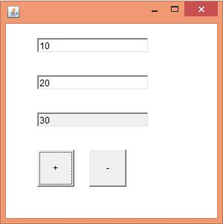
TextField Example
public static void main(String[] args) {
new TextFieldExample();
}
}

Slide 19
Java MouseListener Interface
The Java MouseListener is notified whenever you change the state of mouse.
It is notified against MouseEvent.
The MouseListener interface is found in java.awt.event package.
It has five methods.
public abstract void mouseClicked(MouseEvent e);
public abstract void mouseEntered(MouseEvent e);
public abstract void mouseExited(MouseEvent e);
public abstract void mousePressed(MouseEvent e);
public abstract void mouseReleased(MouseEvent e);

Slide 20
Example
import java.awt.*;
import java.awt.event.*;
public class MouseListenerExample extends Frame implements MouseListener{
Label l;
MouseListenerExample(){
addMouseListener(this);
l=new Label();
l.setBounds(20,50,100,20);
add(l);
setSize(300,300);
setLayout(null);
setVisible(true);
}

Slide 21
Example
public void mouseClicked(MouseEvent e) {
l.setText("Mouse Clicked");
}
public void mouseEntered(MouseEvent e) {
l.setText("Mouse Entered");
}
public void mouseExited(MouseEvent e) {
l.setText("Mouse Exited");
}

Slide 22
Example
public void mousePressed(MouseEvent e) {
l.setText("Mouse Pressed");
}
public void mouseReleased(MouseEvent e) {
l.setText("Mouse Released");
}
public static void main(String[] args) {
new MouseListenerExample();
}
}

Slide 23
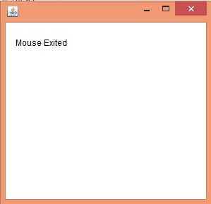
Example

Slide 24
MouseMotionListener
The Java MouseMotionListener is notified whenever you move or drag mouse.
It is notified against MouseEvent.
The MouseMotionListener interface is found in java.awt.event package. It has two methods.
public abstract void mouseDragged(MouseEvent e);
public abstract void mouseMoved(MouseEvent e);

Slide 25
Example
import java.awt.*;
import java.awt.event.MouseEvent;
import java.awt.event.MouseMotionListener;
public class Paint extends Frame implements MouseMotionListener{
Label l;
Color c=Color.BLUE;
Paint(){
l=new Label();
l.setBounds(20,40,100,20);
add(l);
addMouseMotionListener(this);

Slide 26
Example
setSize(400,400);
setLayout(null);
setVisible(true);
}
public void mouseDragged(MouseEvent e) {
l.setText("X="+e.getX()+", Y="+e.getY());
Graphics g=getGraphics();
g.setColor(Color.RED);
g.fillOval(e.getX(),e.getY(),20,20);
}

Slide 27
Example
public void mouseMoved(MouseEvent e) {
l.setText("X="+e.getX()+", Y="+e.getY());
}
public static void main(String[] args) {
new Paint();
}
}

Slide 28
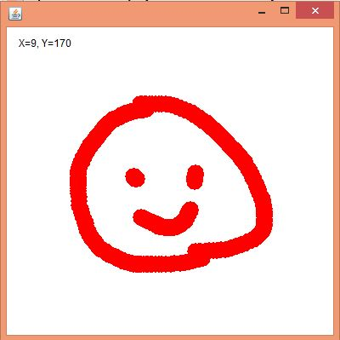
Example

Slide 29
Java ItemListener Interface
The Java ItemListener is notified whenever you click on the checkbox.
It is notified against ItemEvent.
The ItemListener interface is found in java.awt.event package.
It has only one method: itemStateChanged().
itemStateChanged() method
The itemStateChanged() method is invoked automatically whenever you click or unclick on the registered checkbox component.

Slide 30
Example
checkBox1.addItemListener(this);
checkBox2.addItemListener(this);
f.setSize(400,400);
f.setLayout(null);
f.setVisible(true);
}
public void itemStateChanged(ItemEvent e) {
if(e.getSource()==checkBox1)
label.setText("C++ Checkbox: "
+ (e.getStateChange()==1?"checked":"unchecked"));
if(e.getSource()==checkBox2)
label.setText("Java Checkbox: "
+ (e.getStateChange()==1?"checked":"unchecked"));
}

Slide 31
Example
public static void main(String args[])
{
new ItemListenerExample();
}
}

Slide 32
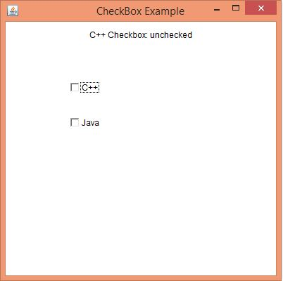
Example

Slide 33
Java KeyListener Interface
The Java KeyListener is notified whenever you change the state of key.
It is notified against KeyEvent.
The KeyListener interface is found in java.awt.event package. It has three methods.
public abstract void keyPressed(KeyEvent e);
public abstract void keyReleased(KeyEvent e);
public abstract void keyTyped(KeyEvent e);

Slide 34
Java KeyListener Interface
import java.awt.*;
import java.awt.event.*;
public class KeyListenerExample extends Frame implements KeyListener{
Label l;
TextArea area;
KeyListenerExample(){
l=new Label();
l.setBounds(20,50,100,20);
area=new TextArea();
area.setBounds(20,80,300, 300);
area.addKeyListener(this);

Slide 35
Java KeyListener Interface
add(l);add(area);
setSize(400,400);
setLayout(null);
setVisible(true);
}
public void keyPressed(KeyEvent e) {
l.setText("Key Pressed");
}

Slide 36
Java KeyListener Interface
public void keyReleased(KeyEvent e) {
l.setText("Key Released");
}
public void keyTyped(KeyEvent e) {
l.setText("Key Typed");
}
public static void main(String[] args) {
new KeyListenerExample();
}
}

Slide 37
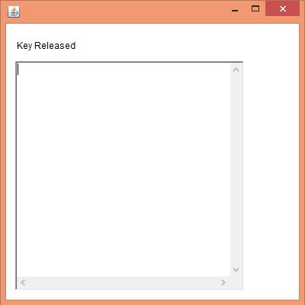
Java KeyListener Interface

